Slide 1
Amortized optimization for optimal transport
Brandon Amos • Meta (FAIR) NYC
http://github.com/bamos/presentations

Slide 2
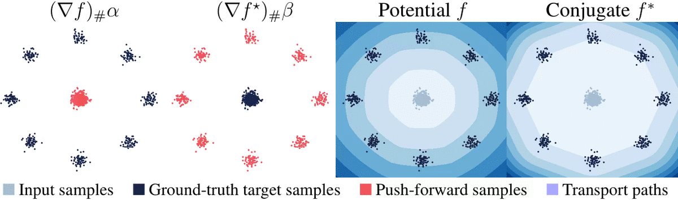
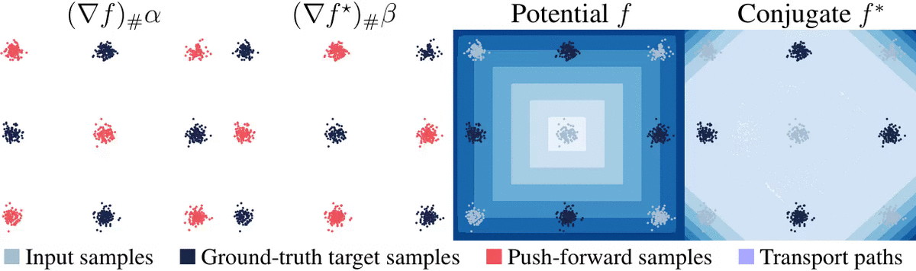
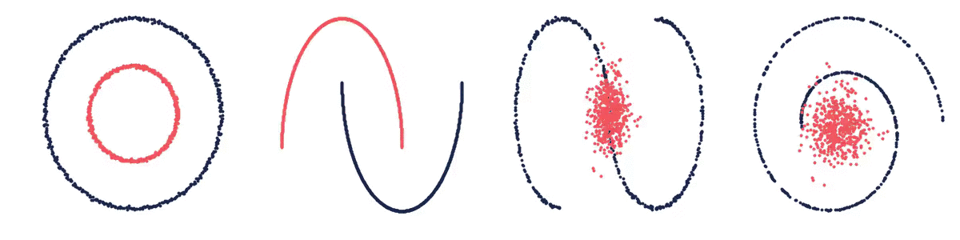
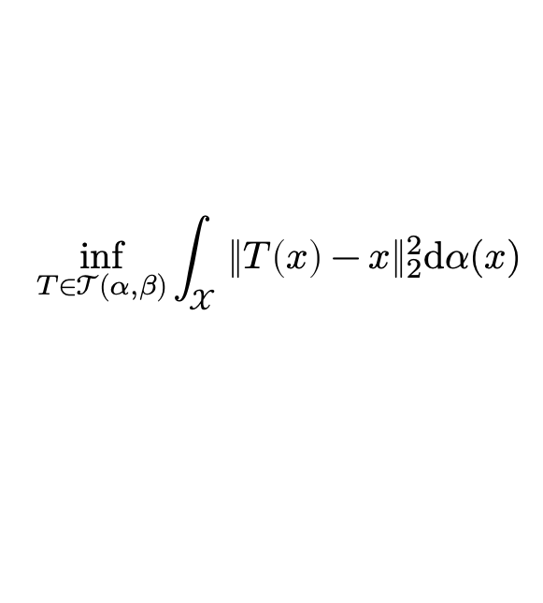
What is optimal transport?
a way of connecting probability measures
📚 Optimal transport: old and new. Villani, 2009. 📚 Optimal Transport in Learning, Control, and Dynamical Systems. Bunne and Cuturi, ICML 2023 Tutorial. 📚 Computational Optimal Transport. Peyré and Cuturi, Foundations and Trends in Machine Learning, 2019.
📚 Optimal Transport for Applied Mathematicians. Santambrogio, Birkhäuser, 2015
📚 Optimal Transport in Systems and Control. Chen, Georgiou, and Pavon, Annual Review of Control, Robotics, and Autonomous Systems, 2021.
📚 Optimal mass transport: Signal processing and machine-learning applications. Kolouri et al., 2017.
Monge’s problem (squared Euclidean)
$$\inf_{T∈𝒯(α, β)}{\int_{𝒳}{{\left\|T\left(x\right)−x\right\|}_{2}^{2}\text{d}α(x)}}$$
find a map connecting $α$ and $β$ that minimally displaces mass
📚 On amortizing convex conjugates for optimal transport. Amos, ICLR 2023.

Slide 3
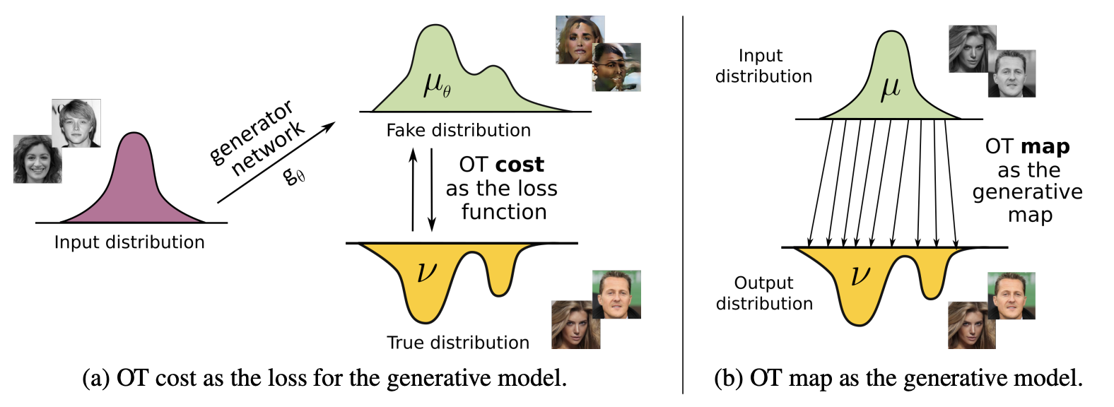
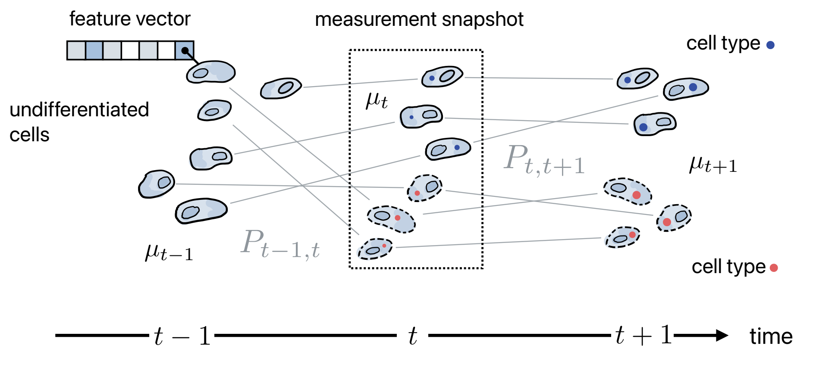
Why optimal transport?
(selected ML-focused highlights)
Defines a metric on the space of measures (metricizes the space of weak convergence)
📚 Wasserstein GAN. Arjovsky, Chintala, Bottou, ICML 2017.
📚 Generalized sliced Wasserstein distances. Kolouri et al., NeurIPS 2019.
📚 Sliced wasserstein distance for learning GMMs. Kolouri et al., CVPR 2018.
📚 Convolutional Wasserstein Distances on Geometric Domains. Solomon et al., ToG 2015.
Couples measures without pairwise data (e.g., for generative modeling, domain adaptation)
📚 Generative modeling via OT maps. Rout, Korotin, Burnaev. ICLR 2022.
📚 Neural Optimal Transport. Korotin et al., ICLR 2023
📚 Neural Monge map estimation. Jiaojiao Fan et al., TMLR 2023.
📚 Joint distribution optimal transportation for domain adaptation. Courty et al., NeurIPS 2017.
📚 Geometric Dataset Distances via Optimal Transport. Alvarez-Melis et al., NeurIPS 2020.
source: Rout et al.
Finds interpolating paths between populations (e.g., for cell populations or multi-agent systems)
📚 Optimal-transport analysis of single-cell gene expression. Schiebinger et al., Cell 2019.
📚 Learning single-cell perturbation responses using neural optimal transport. Bunne et al., Nature Methods 2023.
📚 Likelihood Training of Schrödinger Bridge. Liu, Horng, Theodorou. ICLR 2022.
📚 Trajectorynet: A dynamic optimal transport network for modeling cellular dynamics. Tong et al., ICML 2020.
source: Bunne and Cuturi

Slide 4
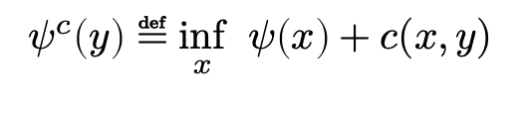
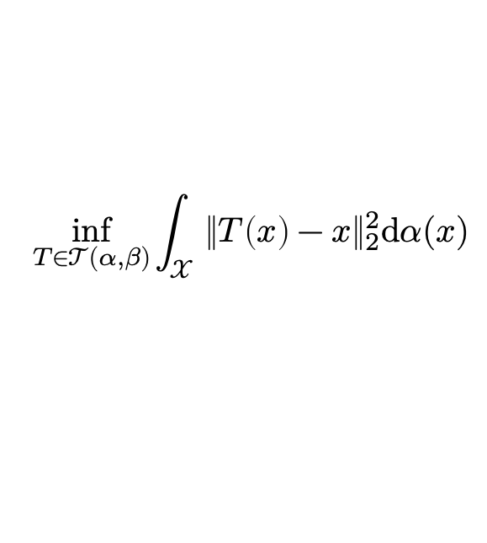
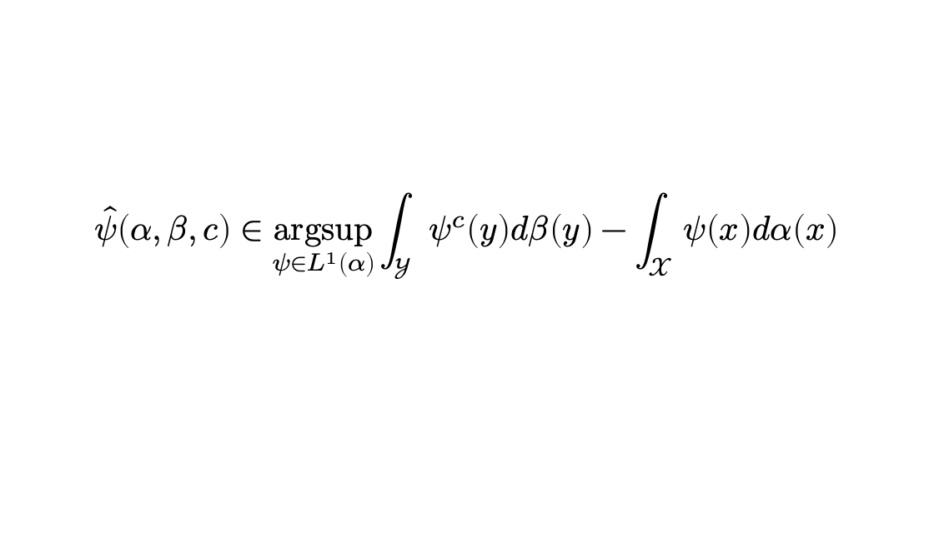
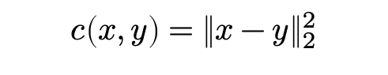
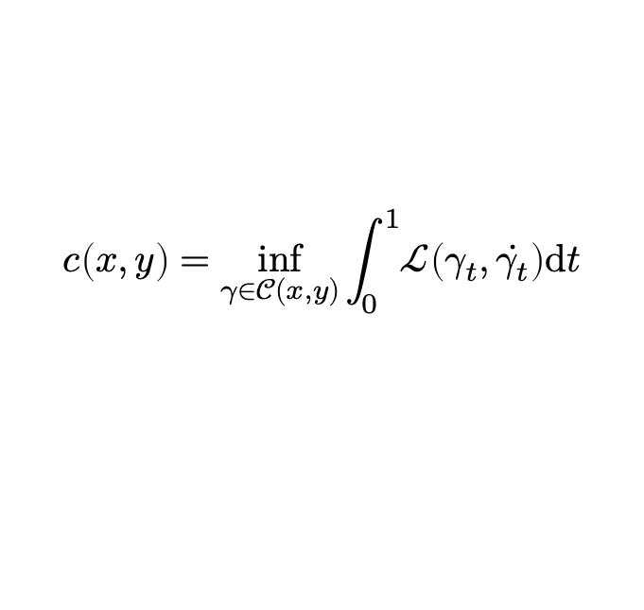
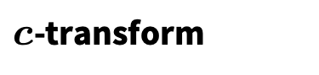
Optimization problems and sub-problems in OT
📚 GeomLoss. Feydy et al., AISTATS 2019. 📚 Python Optimal Transport. Flamary et al., JMLR 2021. 📚 Optimal Transport Tools. Cuturi et al., 2022.
Primal formulations
Kantorovich dual
Monge (squared Euclidean)
$$\hat{ψ}\left(α, β, c\right)∈\underset{ψ∈L^{1}\left(α\right)}{argsup}{\int_{𝒴}{ψ^{c}\left(y\right)dβ\left(y\right)}−\int_{𝒳}{ψ\left(x\right)dα\left(x\right)}}$$
$$\inf_{T∈𝒯(α, β)}{\int_{𝒳}{{\left\|T\left(x\right)−x\right\|}_{2}^{2}\text{d}α(x)}}$$
$c$-transform
Kantorovich
$$ψ^{c}\left(y\right)≝\inf_{x}{ ψ\left(x\right)+c(x,y)}$$
…
Costs
Squared Euclidean
Lagrangian (e.g., geodesics)
Easy when convex, finite-dimensional Linear programming, Sinkhorn (entropic), forward-backward May be hard otherwise continuous, high-dimensional
$$c\left(x,y\right)=\inf_{γ∈𝒞(x,y)}{\int_{0}^{1}{ℒ\left(γ_{t}, \dot{γ_{t}}\right)\text{d}t}}$$
$$c\left(x,y\right)={\left\|x−y\right\|}_{2}^{2}$$

Slide 5
Can ML help /solve/ OT problems? Yes!
by rapidly predicting approximate solutions
📚 Tutorial on amortized optimization. Amos. FnT in ML, 2023.
Primal formulations
Kantorovich dual
amortize this
Monge (squared Euclidean)
$$\hat{ψ}\left(α, β, c\right)∈\underset{ψ∈L^{1}\left(α\right)}{argsup}{\int_{𝒴}{ψ^{c}\left(y\right)dβ\left(y\right)}−\int_{𝒳}{ψ\left(x\right)dα\left(x\right)}}$$
$$\inf_{T∈𝒯(α, β)}{\int_{𝒳}{{\left\|T\left(x\right)−x\right\|}_{2}^{2}\text{d}α(x)}}$$
$c$-transform
Kantorovich
$$ψ^{c}\left(y\right)≝\inf_{x}{ ψ\left(x\right)+c(x,y)}$$
amortize that
…
Costs
Squared Euclidean
Lagrangian (e.g., geodesics)
and this
$$c\left(x,y\right)={\left\|x−y\right\|}_{2}^{2}$$
$$c\left(x,y\right)=\inf_{γ∈𝒞(x,y)}{\int_{0}^{1}{ℒ\left(γ_{t}, \dot{γ_{t}}\right)\text{d}t}}$$
See also:
📚 Amortized projection optimization for sliced Wasserstein. Nguyen et al., NeurIPS 2022.

Slide 6
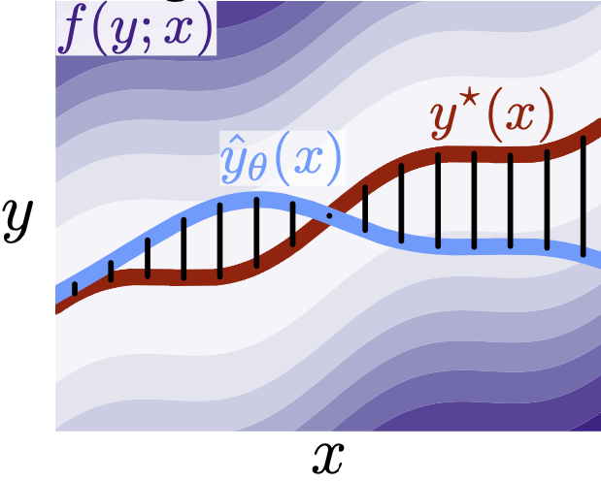
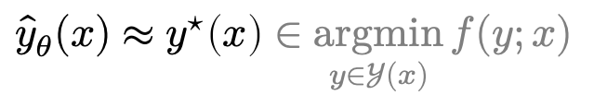
Why call it amortized optimization?
📚 Tutorial on amortized optimization. Amos. FnT in ML, 2023.
*also referred to as learned optimization
to amortize: to spread out an upfront cost over time
$${\hat{y}}_{θ}(x)≈y^{⋆}\left(x\right)∈\underset{y∈𝒴(x)}{argmin}{f(y;x)}$$
expensive upfront cost
training the model
fast approximate solutions
Vertical slices are optimization problems

Slide 7
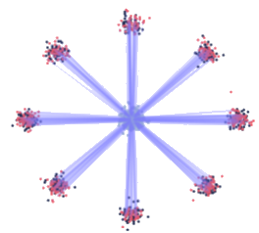
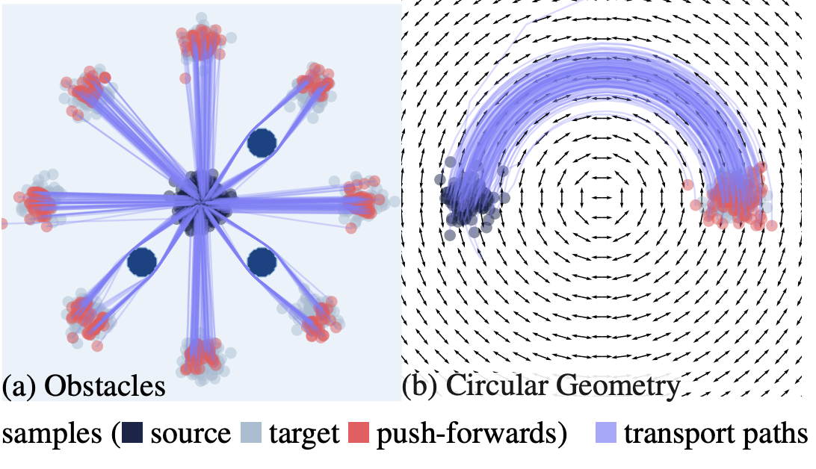
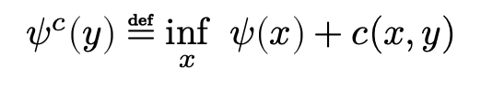
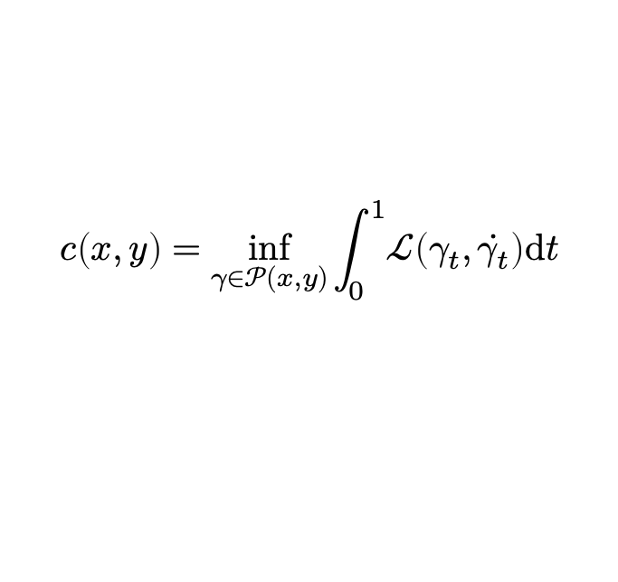
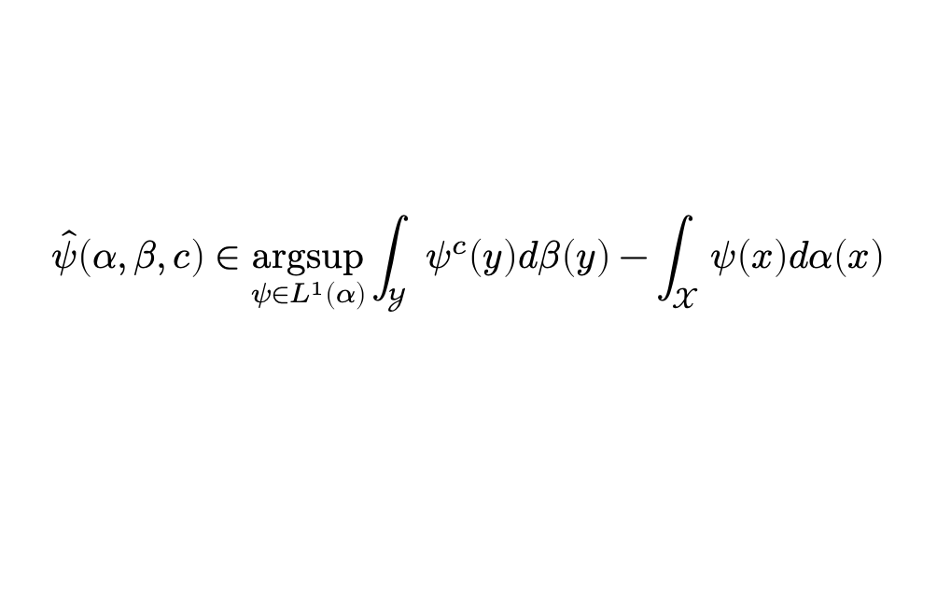
This talk: amortized optimization for OT
OT problems (Monge maps, dual potentials)
📚 Supervised training of conditional Monge maps. Bunne et al., NeurIPS 2022.
📚 Meta Optimal Transport. Amos et al., ICML 2023.
$$\hat{ψ}\left(α, β, c\right)∈\underset{ψ∈L^{1}\left(α\right)}{argsup}{\int_{𝒴}{ψ^{c}\left(y\right)dβ\left(y\right)}−\int_{𝒳}{ψ\left(x\right)dα\left(x\right)}}$$
The $c$-transform (e.g., the convex conjugate)
📚 Optimal transport mapping via input convex neural networks. Makkuva et al., ICML 2020.
📚 Wasserstein-2 Generative Networks. Korotin et al., ICLR 2021.
📚 On amortizing convex conjugates for optimal transport. Amos, ICLR 2023.
$$ψ^{c}\left(y\right)≝\inf_{x}{ ψ\left(x\right)+c(x,y)}$$
Lagrangian costs (e.g., geodesic distances)
📚 Deep Generalized Schrödinger Bridge. Liu et al., NeurIPS 2022.
📚 Riemannian metric learning via optimal transport. Scarvelis and Solomon, ICLR 2023.
📚 Neural Lagrangian Schrödinger Bridge. Koshizuka and Sato, ICLR 2023.
📚 Neural Optimal Transport with Lagrangian Costs. Pooladian, Domingo-Enrich, Chen, Amos, 2023.
📚 A Computational Framework for Solving Wasserstein Lagrangian Flows. Neklyudov et al., 2023. 📚 Generalized Schrödinger Bridge Matching. Liu et al., 2023.
$$c\left(x,y\right)=\inf_{γ∈𝒫(x,y)}{\int_{0}^{1}{ℒ\left(γ_{t}, \dot{γ_{t}}\right)\text{d}t}}$$

Slide 8
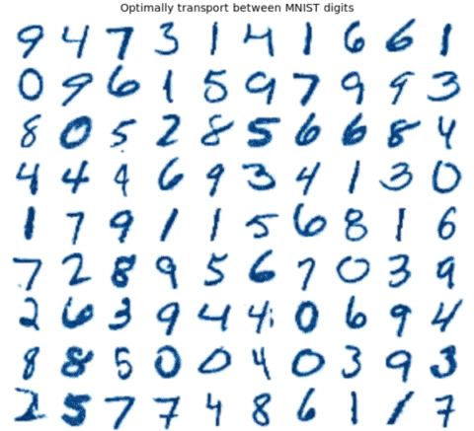
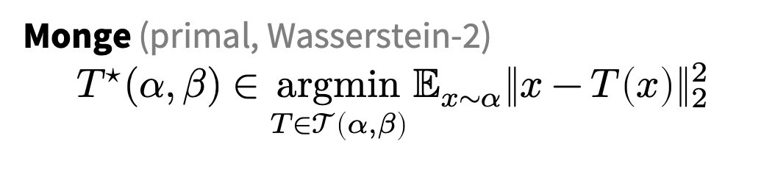
Challenge: computing OT maps
📚 Meta Optimal Transport. Amos et al., ICML 2023.
Monge (primal, Wasserstein-2)
$${T^{⋆}(α, β)∈\underset{T∈𝒯\left(α, β\right)}{argmin}{𝔼_{x∼α}\left\|x−T\left(x\right)\right\|}}_{2}^{2}$$
we also consider other/discrete OT formulations
Many OT problems are numerically solved
Improving OT solvers is active research
Solving multiple OT problems: even harder
Standard solution: independently solve

Slide 9
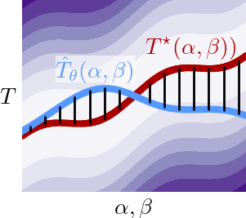
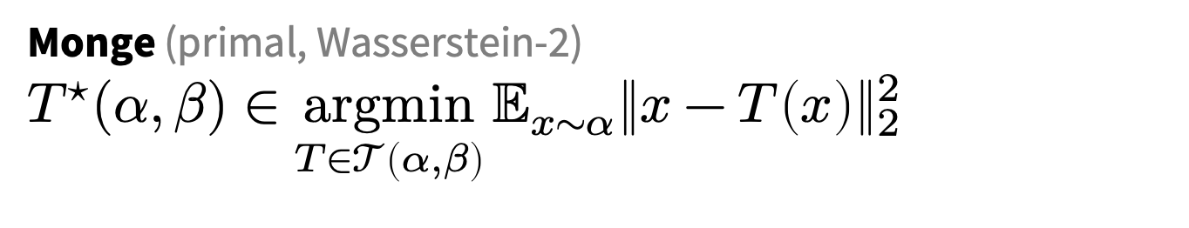

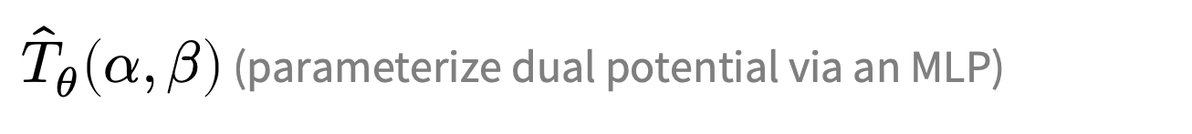
Meta Optimal Transport
Idea: predict the solution to OT problems with amortized optimization
Simultaneously solve many OT problems, sharing info between instances
Why call it “meta”? Instead of solving a single OT problem, learn how to solve many
Monge (primal, Wasserstein-2)
$${T^{⋆}(α, β)∈\underset{T∈𝒯\left(α, β\right)}{argmin}{𝔼_{x∼α}\left\|x−T\left(x\right)\right\|}}_{2}^{2}$$
$$≈$$
${\hat{T}}_{θ}\left(α, β\right)$ (parameterize dual potential via an MLP)
we also consider other/discrete OT formulations

Slide 10
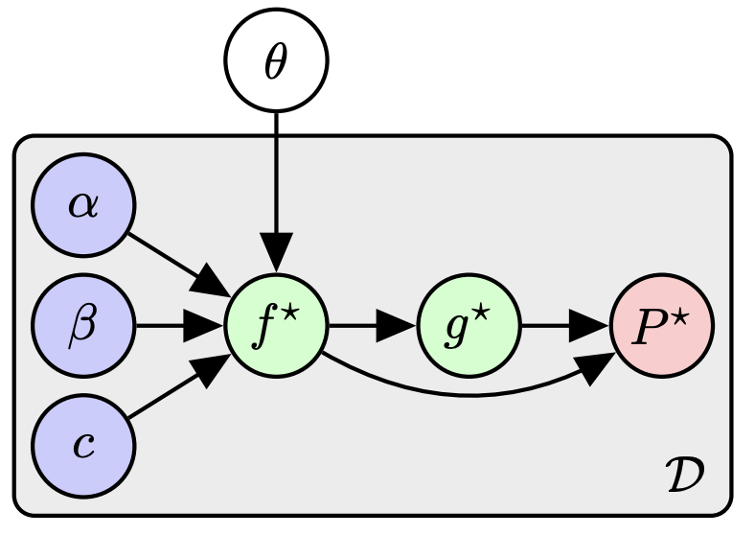
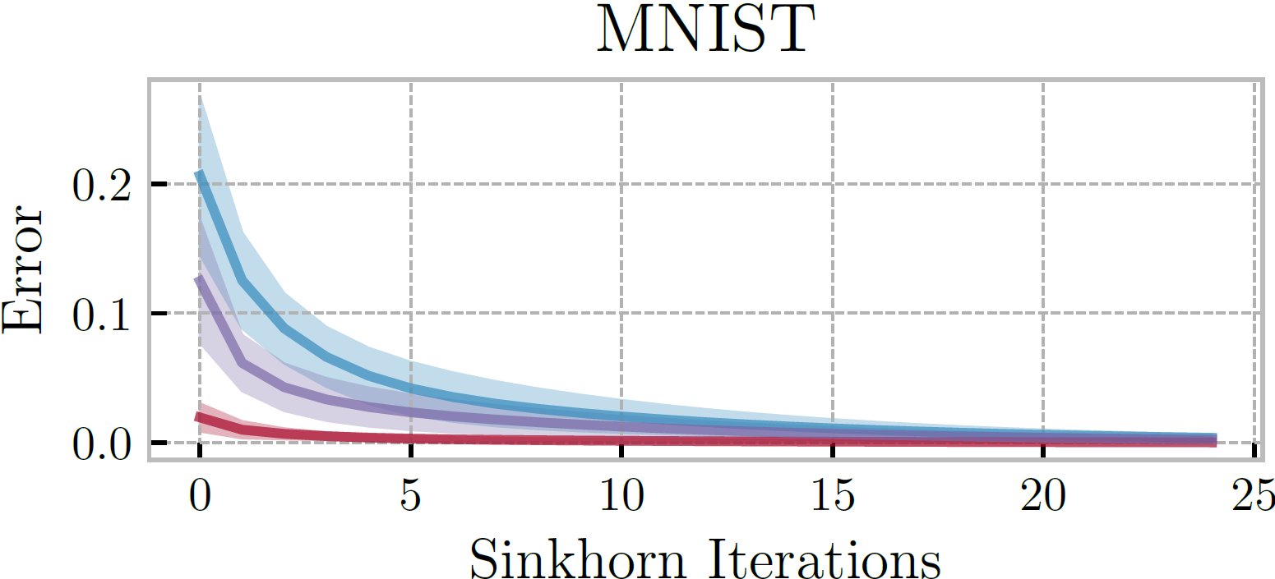
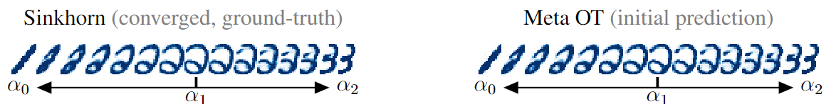
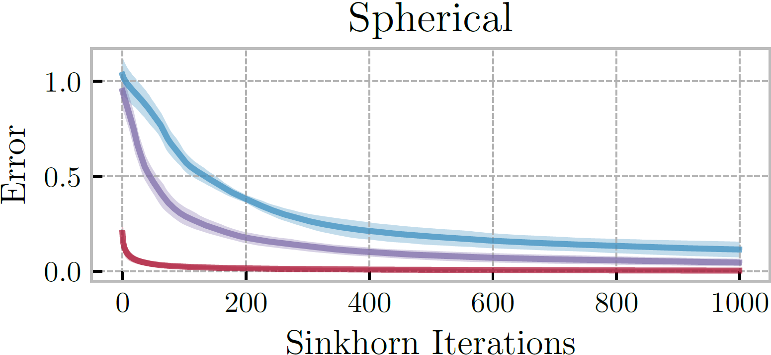
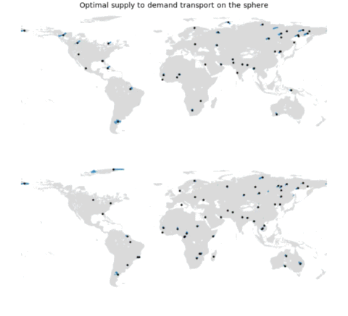
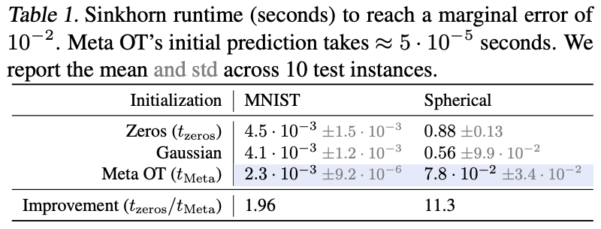
Meta OT for Discrete OT (Sinkhorn)
📚 Sinkhorn Distances: Lightspeed Computation of Optimal Transport. Marco Cuturi, NeurIPS 2013.

Slide 11
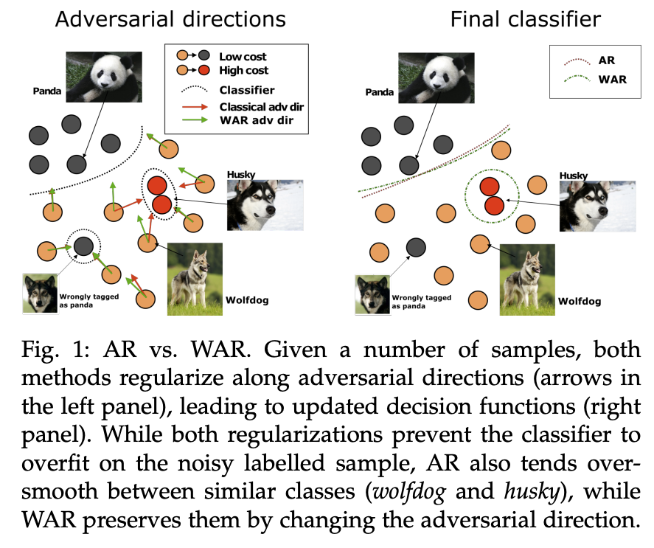
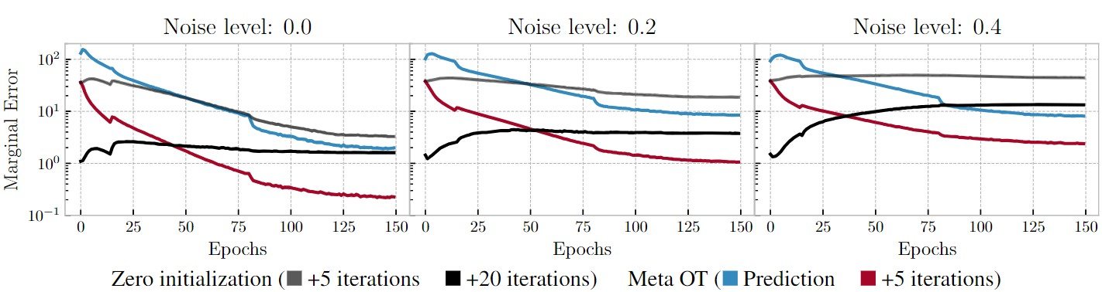
Wasserstein adversarial regularization
📚 Wasserstein adversarial regularization for learning with label noise. Kilian Fatras et al., TPAMI 2021.
Setting: discrete OT for classification with label noise
OT is repeatedly solved across minibatches
Use Meta OT to learn better solutions

Slide 12
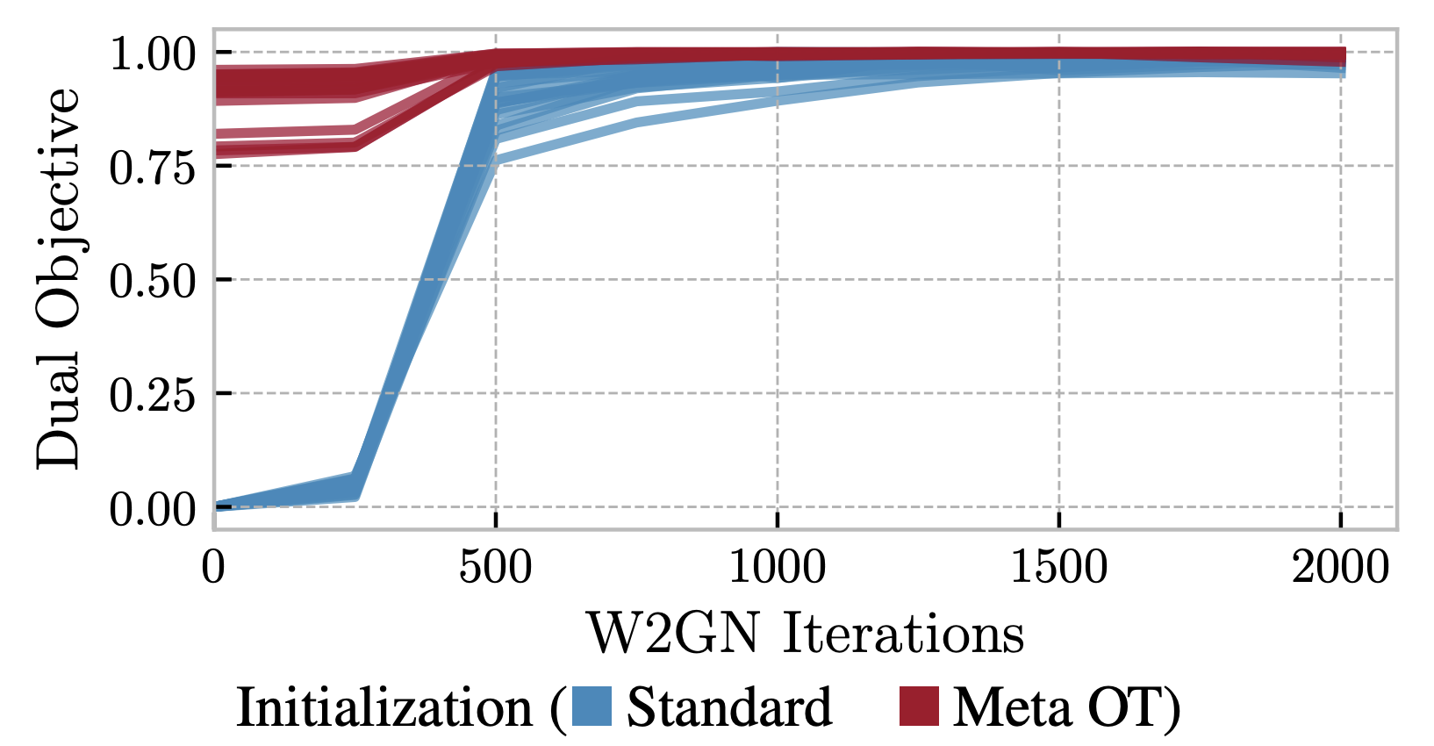
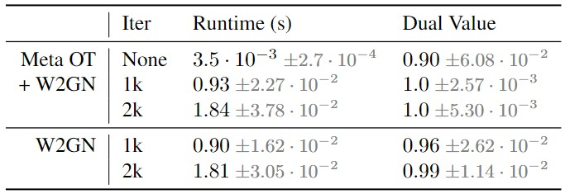
Meta OT in continuous settings (W2GN)
📚 Wasserstein-2 Generative Networks. Alexander Korotin et al., ICLR 2021.
RGB color palette transport

Slide 13
More Meta OT color transfer predictions
📚 Meta Optimal Transport. Amos et al., ICML 2023.

Slide 14
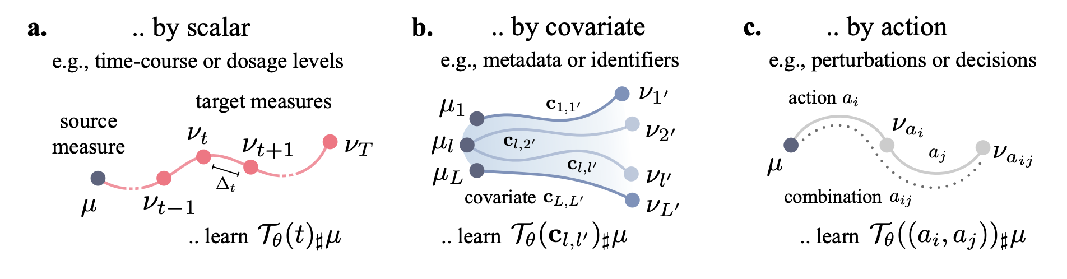
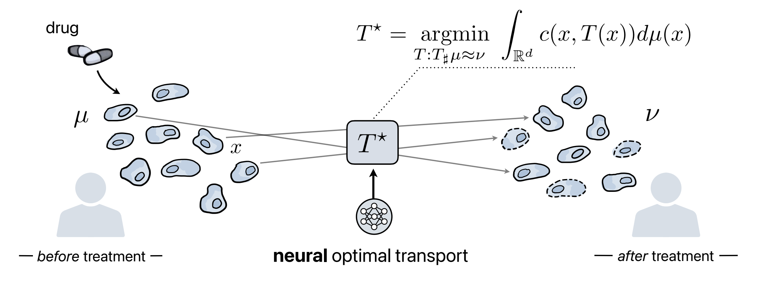
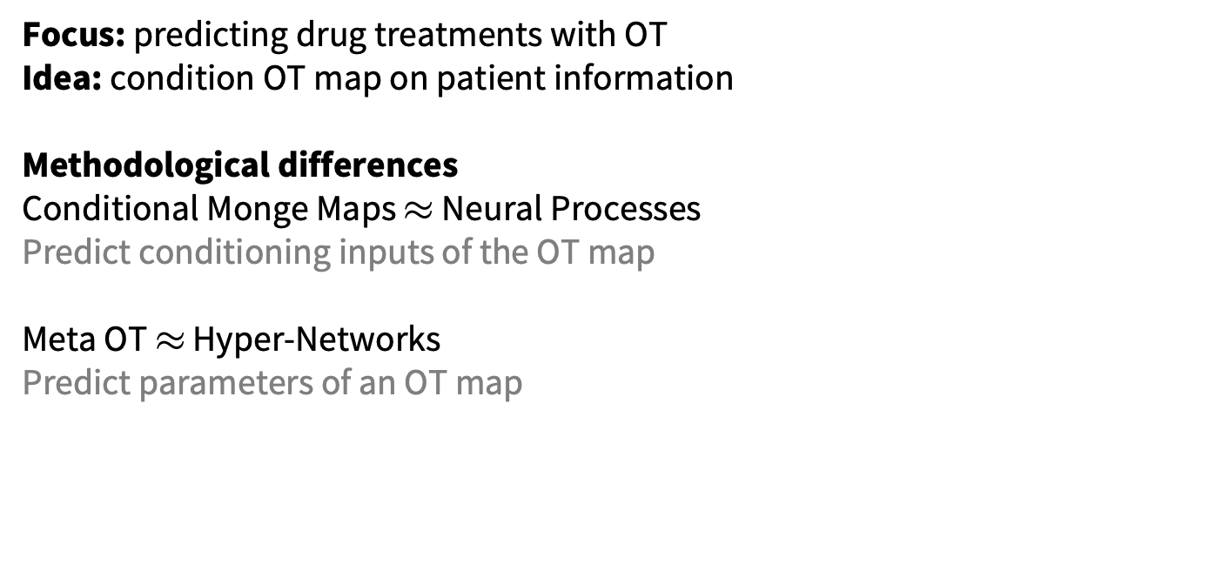
Conditional Monge Maps
📚 Supervised Training of Conditional Monge Maps. Bunne, Krause, Cuturi, NeurIPS 2022.
Focus: predicting drug treatments with OT
Idea: condition OT map on patient information
Methodological differences
Conditional Monge Maps $≈$ Neural Processes
Predict conditioning inputs of the OT map Meta OT $≈$ Hyper-Networks
Predict parameters of an OT map
image sources: Bunne and Cuturi

Slide 15
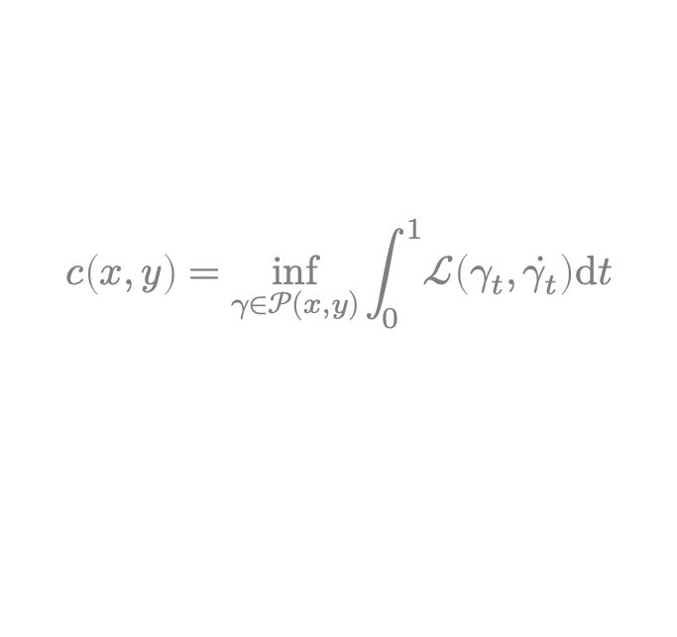
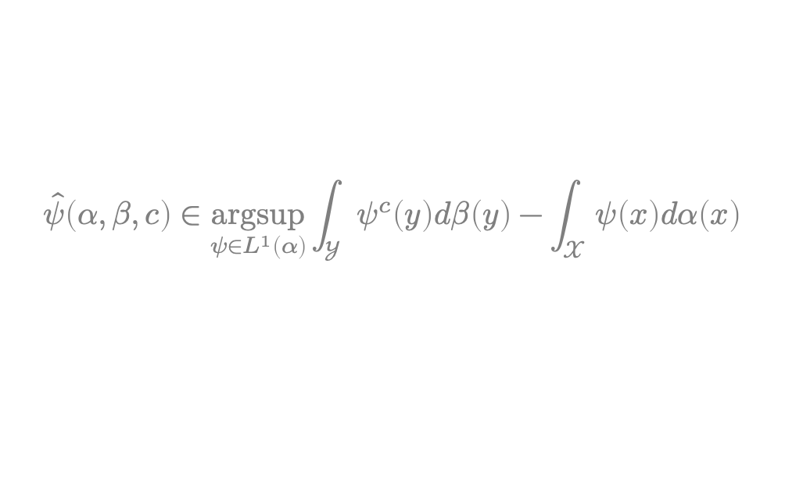
This talk: amortized optimization for OT
OT problems (Monge maps, dual potentials)
📚 Supervised training of conditional Monge maps. Bunne et al., NeurIPS 2022.
📚 Meta Optimal Transport. Amos et al., ICML 2023.
$$\hat{ψ}\left(α, β, c\right)∈\underset{ψ∈L^{1}\left(α\right)}{argsup}{\int_{𝒴}{ψ^{c}\left(y\right)dβ\left(y\right)}−\int_{𝒳}{ψ\left(x\right)dα\left(x\right)}}$$
The $c$-transform (e.g., the convex conjugate)
📚 Optimal transport mapping via input convex neural networks. Makkuva et al., ICML 2020.
📚 Wasserstein-2 Generative Networks. Korotin et al., ICLR 2021.
📚 On amortizing convex conjugates for optimal transport. Amos, ICLR 2023.
$$ψ^{c}\left(y\right)≝\inf_{x}{ ψ\left(x\right)+c(x,y)}$$
Lagrangian costs (e.g., geodesic distances)
📚 Deep Generalized Schrödinger Bridge. Liu et al., NeurIPS 2022.
📚 Riemannian metric learning via optimal transport. Scarvelis and Solomon, ICLR 2023.
📚 Neural Lagrangian Schrödinger Bridge. Koshizuka and Sato, ICLR 2023.
📚 Neural Optimal Transport with Lagrangian Costs. Pooladian, Domingo-Enrich, Chen, Amos, 2023.
📚 A Computational Framework for Solving Wasserstein Lagrangian Flows. Neklyudov et al., 2023. 📚 Generalized Schrödinger Bridge Matching. Liu et al., 2023.
$$c\left(x,y\right)=\inf_{γ∈𝒫(x,y)}{\int_{0}^{1}{ℒ\left(γ_{t}, \dot{γ_{t}}\right)\text{d}t}}$$

Slide 16
Solving Kantorovich’s dual with a neural net
📚 2-wasserstein approximation via restricted convex potentials. Taghvaei and Jalali, 2019.
📚 Three-Player Wasserstein GAN via Amortised Duality. Nhan Dam et al., IJCAI 2019.
📚 Optimal transport mapping via input convex neural networks. Makkuva et al., ICML 2020.
📚 Wasserstein-2 generative networks. Korotin et al., ICLR 2020. 📚 The monge gap. Uscidda and Cuturi, ICML 2023.
📚 On amortizing convex conjugates for optimal transport. Amos, ICLR 2023.

Slide 17
Focus: computing the conjugate
📚 2-wasserstein approximation via restricted convex potentials. Taghvaei and Jalali, 2019.
📚 Three-Player Wasserstein GAN via Amortised Duality. Nhan Dam et al., IJCAI 2019.
📚 Optimal transport mapping via input convex neural networks. Makkuva et al., ICML 2020.
📚 Wasserstein-2 generative networks. Korotin et al., ICLR 2020. 📚 The monge gap. Uscidda and Cuturi, ICML 2023.
📚 On amortizing convex conjugates for optimal transport. Amos, ICLR 2023.
Amortization: approximate the arginf with (another) neural network

Slide 18
Conjugate amortization loss choices
📚 On amortizing convex conjugates for optimal transport. Amos, ICLR 2023.

Slide 19
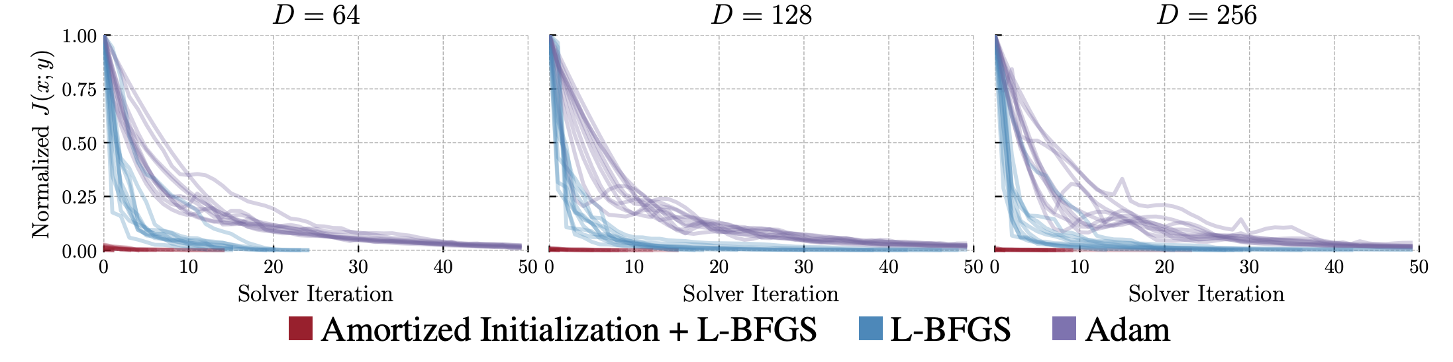
Insight: inaccurate predictions are still useful
📚 On amortizing convex conjugates for optimal transport. Amos, ICLR 2023.
Concern: inaccurate predictions of the conjugate give a biased estimation of the OT objective
Solution: optimality conditions can be checked, prediction can be fine tuned we know the true conjugate optimization problem, use existing solvers for it

Slide 20
Wasserstein-2 benchmark results
📚 On amortizing convex conjugates for optimal transport. Amos, ICLR 2023. 📚 Do Neural Optimal Transport Solvers Work? Korotin et al., NeurIPS 2021.
Takeaway: amortization choice important, fine-tuning significantly helps
HD benchmarks: Unexplained Variance Percentage (UVP, lower is better)
CelebA benchmarks: UVP

Slide 21

Transport between synthetic measures

Slide 22
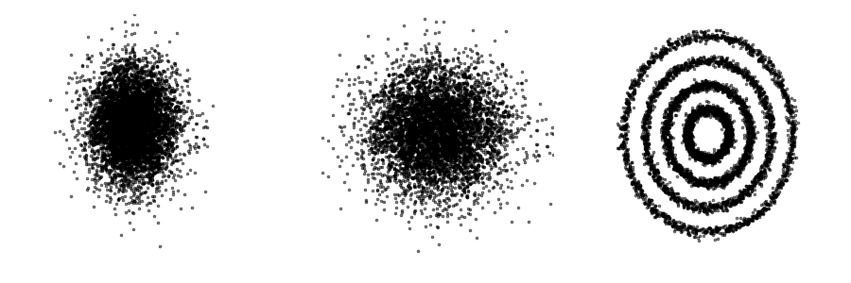

Learning flows via continuous OT
📚 On amortizing convex conjugates for optimal transport. Amos, ICLR 2023.
Continuous OT for flows:
Works only from samples (no likelihoods needed)
No need to explicitly enforce invertibility
No need to compute the log-det of the Jacobian

Slide 23
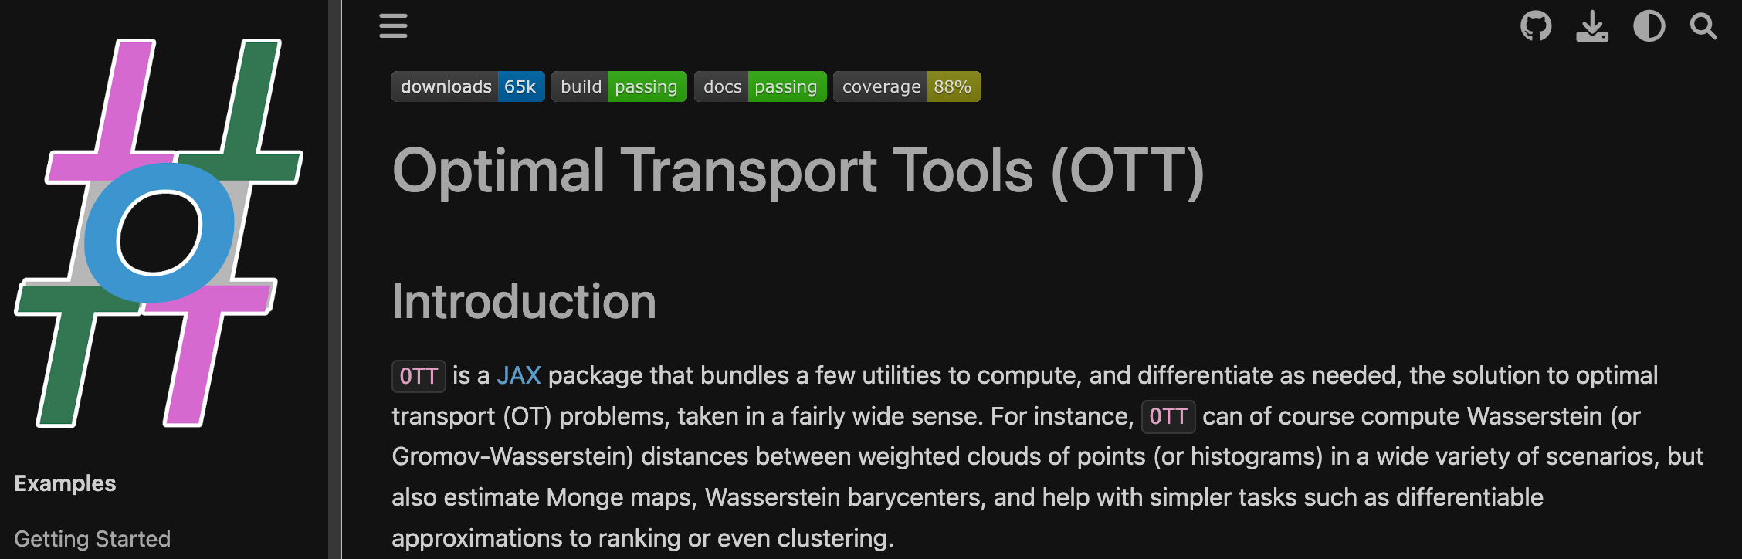
Conjugate amortization+fine-tuning in OTT
github.com/ott-jax/ott
📚 Optimal Transport Tools. Cuturi et al., 2022.

Slide 24
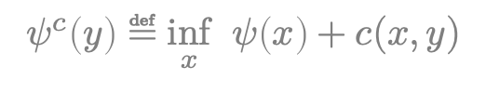
This talk: amortized optimization for OT
OT problems (Monge maps, dual potentials)
📚 Supervised training of conditional Monge maps. Bunne et al., NeurIPS 2022.
📚 Meta Optimal Transport. Amos et al., ICML 2023.
$$\hat{ψ}\left(α, β, c\right)∈\underset{ψ∈L^{1}\left(α\right)}{argsup}{\int_{𝒴}{ψ^{c}\left(y\right)dβ\left(y\right)}−\int_{𝒳}{ψ\left(x\right)dα\left(x\right)}}$$
The $c$-transform (e.g., the convex conjugate)
📚 Optimal transport mapping via input convex neural networks. Makkuva et al., ICML 2020.
📚 Wasserstein-2 Generative Networks. Korotin et al., ICLR 2021.
📚 On amortizing convex conjugates for optimal transport. Amos, ICLR 2023.
$$ψ^{c}\left(y\right)≝\inf_{x}{ ψ\left(x\right)+c(x,y)}$$
Lagrangian costs (e.g., geodesic distances)
📚 Deep Generalized Schrödinger Bridge. Liu et al., NeurIPS 2022.
📚 Riemannian metric learning via optimal transport. Scarvelis and Solomon, ICLR 2023.
📚 Neural Lagrangian Schrödinger Bridge. Koshizuka and Sato, ICLR 2023.
📚 Neural Optimal Transport with Lagrangian Costs. Pooladian, Domingo-Enrich, Chen, Amos, 2023.
📚 A Computational Framework for Solving Wasserstein Lagrangian Flows. Neklyudov et al., 2023. 📚 Generalized Schrödinger Bridge Matching. Liu et al., 2023.
$$c\left(x,y\right)=\inf_{γ∈𝒫(x,y)}{\int_{0}^{1}{ℒ\left(γ_{t}, \dot{γ_{t}}\right)\text{d}t}}$$

Slide 25
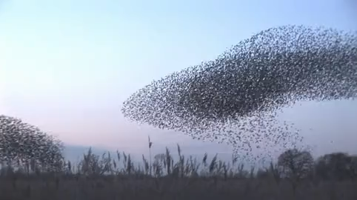
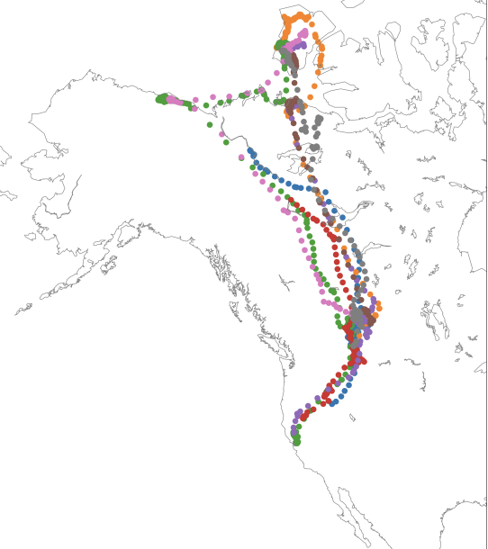
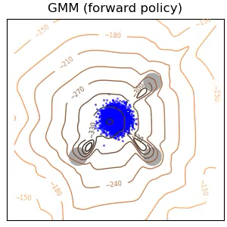

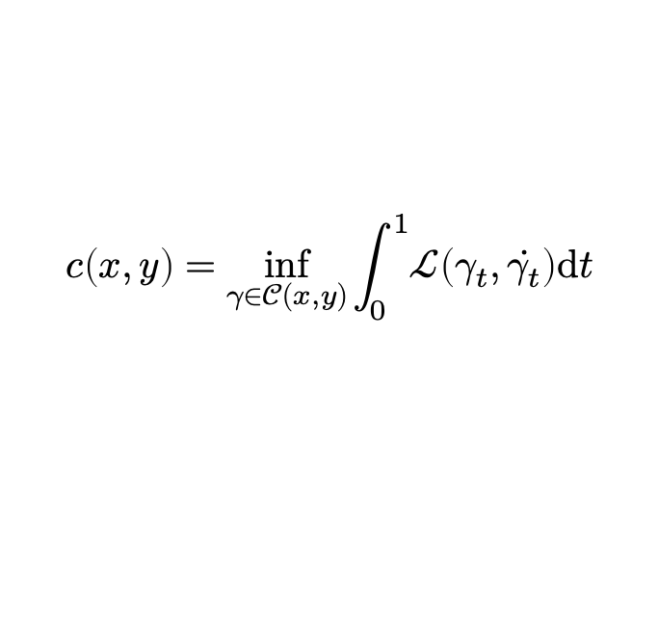
From Euclidean to Lagrangian costs
incorporates physical knowledge from the world (e.g., obstacles, manifolds)
📚 Deep Generalized Schrödinger Bridge. Liu et al., NeurIPS 2022.
📚 Riemannian metric learning via optimal transport. Scarvelis and Solomon, ICLR 2023.
📚 Neural Lagrangian Schrödinger Bridge. Koshizuka and Sato, ICLR 2023.
📚 Neural Optimal Transport with Lagrangian Costs. Pooladian, Domingo-Enrich, Chen, Amos, 2023.
📚 A Computational Framework for Solving Wasserstein Lagrangian Flows. Neklyudov et al., 2023.
📚 Generalized Schrödinger Bridge Matching. Liu et al., 2023.
Lagrangian (e.g., geodesics)
Squared Euclidean
$$c\left(x,y\right)=\inf_{γ∈𝒞(x,y)}{\int_{0}^{1}{ℒ\left(γ_{t}, \dot{γ_{t}}\right)\text{d}t}}$$
$$c\left(x,y\right)={\left\|x−y\right\|}_{2}^{2}$$
source
source: Scarvelis and Solomon
source: Liu et al., 2023.

Slide 26
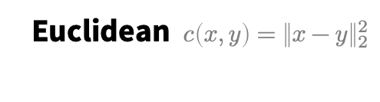
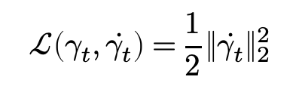
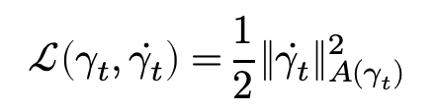


Expressivity of Lagrangian costs
📚 Neural Optimal Transport with Lagrangian Costs. Pooladian, Domingo-Enrich, Chen, Amos, 2023. (and many others!)
$$c\left(x,y\right)=\inf_{γ∈𝒞(x,y)}{\int_{0}^{1}{ℒ\left(γ_{t}, \dot{γ_{t}}\right)\text{d}t}}$$
Euclidean $c\left(x,y\right)={\left\|x−y\right\|}_{2}^{2}$
Potential term (e.g., obstacles)
Riemannian geodesics
$$ℒ\left(γ_{t}, \dot{γ_{t}}\right)=\frac{1}{2}{\left\|\dot{γ_{t}}\right\|}_{2}^{2}$$
$$ℒ\left(γ_{t}, \dot{γ_{t}}\right)=\frac{1}{2}{\left\|\dot{γ_{t}}\right\|}_{2}^{2}−U(γ_{t})$$
$$ℒ\left(γ_{t}, \dot{γ_{t}}\right)=\frac{1}{2}{\left\|\dot{γ_{t}}\right\|}_{A(γ_{t})}^{2}$$
easy, closed-form computation
challenging in general, no known closed-form solutions

Slide 27



Our approach: amortize the geodesic path!
enables us to solve the static OT formulation
📚 Neural Optimal Transport with Lagrangian Costs. Pooladian, Domingo-Enrich, Chen, Amos, 2023.
$${\tilde{γ}}_{θ}\left(x,y\right)≈γ^{⋆}\left(x,y\right)=\underset{γ∈𝒫(x,y)}{arginf}{\int_{0}^{1}{ℒ\left(γ_{t}, \dot{γ_{t}}\right)\text{d}t}}$$
Euclidean $c\left(x,y\right)={\left\|x−y\right\|}_{2}^{2}$
Potential term (e.g., obstacles)
Riemannian geodesics
$$ℒ\left(γ_{t}, \dot{γ_{t}}\right)=\frac{1}{2}{\left\|\dot{γ_{t}}\right\|}_{2}^{2}$$
$$ℒ\left(γ_{t}, \dot{γ_{t}}\right)=\frac{1}{2}{\left\|\dot{γ_{t}}\right\|}_{2}^{2}−U(γ_{t})$$
$$ℒ\left(γ_{t}, \dot{γ_{t}}\right)=\frac{1}{2}{\left\|\dot{γ_{t}}\right\|}_{A(γ_{t})}^{2}$$
easy, closed-form computation
challenging in general, no known closed-form solutions

Slide 28



Excels at solving OT and learning metrics
📚 Neural Optimal Transport with Lagrangian Costs. Pooladian, Domingo-Enrich, Chen, Amos, 2023. (and many others!)

Slide 29

Amortized optimization beyond OT 🚀
Reinforcement learning and control (actor-critic methods, SAC, DDPG, GPS, BC)
Variational inference (amortized VI, VAEs, semi-amortized VAEs)
Meta-learning (HyperNets, MAML)
Sparse coding (PSD, LISTA)
Roots, fixed points, and convex optimization (NeuralDEQs, RLQP, NeuralSCS)
Optimal transport (slicing, conjugation, Meta Optimal Transport, Lagrangian costs)
📚 Foundations and Trends® in Machine Learning

Slide 30





Amortized optimization for optimal transport
Brandon Amos • Meta (FAIR) NYC
http://github.com/bamos/presentations
Kantorovich dual
amortize this
$$\hat{ψ}\left(α, β, c\right)∈\underset{ψ∈L^{1}\left(α\right)}{argsup}{\int_{𝒴}{ψ^{c}\left(y\right)dβ\left(y\right)}−\int_{𝒳}{ψ\left(x\right)dα\left(x\right)}}$$
$c$-transform
$$ψ^{c}\left(y\right)≝\inf_{x}{ ψ\left(x\right)+c(x,y)}$$
amortize that
Costs
Squared Euclidean
Lagrangian (e.g., geodesics)
and this
$$c\left(x,y\right)={\left\|x−y\right\|}_{2}^{2}$$
$$c\left(x,y\right)=\inf_{γ∈𝒞(x,y)}{\int_{0}^{1}{ℒ\left(γ_{t}, \dot{γ_{t}}\right)\text{d}t}}$$

